Slide 1
NetBox Plugin Development Environment
NetBox Day, May 19th
Damien Garros, Managing Director

Slide 2
Agenda
Netbox Onboarding Plugin
Project organization & packaging
Development Environment
Continuous Integration

Slide 3
This Presentation
Target Audience Part 1: All NetBox Users Part 2: NetBox Plugin Developers
Not Mandatory but recommended to understand NetBox Plugin Architecture (previous session)
This presentation is about project organization / development environment

Slide 4
NetBox Onboarding Plugin

Slide 5
NetBox Onboarding Plugin Overview
Plugin for NetBox to easily onboard new devices
Example project to showcase:
How to leverage NetBox Plugin features
How to organize a NetBox Plugin

Slide 6
Device Onboarding User Stories
As a NetBox user,
I want to import my existing devices as easily as possible.
As a NetBox administrator,
I want to empower users to add new devices without being a bottleneck.
I want to ensure all devices imported in NetBox are compliant with company policy. (names, serial, etc..).

Slide 7
NetBox Onboarding Plugin
NetBox Plugin to expose a CSV view, form, and API to easily import new devices.
Minimum requirements to onboard a device is a site name and primary IP address
Onboarding is done in the background via an RQ worker
Status of all onboarding tasks are tracked in the database.

Slide 8
Bootstrapping your inventory
Only create device and management IP address
Do not import everything, just inventory
Manual import often leads to bad data. Automated onboarding leads to higher quality
NetBox Plugin Architecture opens the door to applications beyond the Source of Truth

Slide 9
NetBox As a Platform
Packaging an application/tool as a NetBox plugin allows leveraging existing components:
Django User management and authentication
Caching
Direct access to the Database (ORM)
Async Tasks with Django RQ
UI and API (to some extent)
UI / API
Netbox
App
/ Plugin
Caching
Asynchronous Tasks
User Management
Django

Slide 10
High Level Architecture
UI / API
Postgres
Worker(s)
Onboarding Task Table
Worker(s)
Network Device
Form
Worker(s)
Network Device
Network Device
Discovery & Onboarding
CSV
Network Device
Network Device
Network Device
API (CRUD)
Django RQ
Network Device
Network Device
Default Queue
Network Device

Slide 11
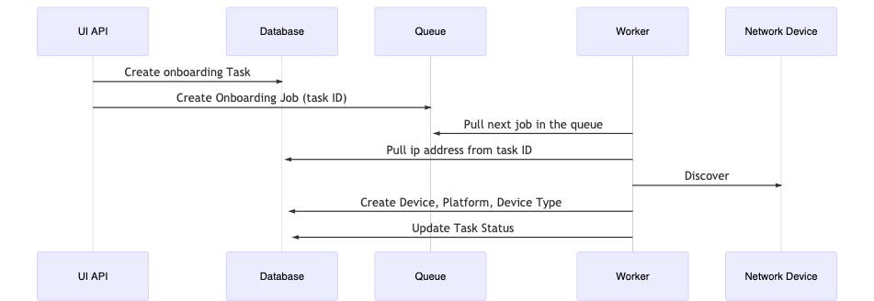
High Level Architecture
Notes:
https://mermaid-js.github.io/mermaid-live-editor/#/edit/eyJjb2RlIjoic2VxdWVuY2VEaWFncmFtXG5cdFVJIEFQSS0-PitEYXRhYmFzZTogQ3JlYXRlIG9uYm9hcmRpbmcgVGFza1xuICBVSSBBUEktPj4rUXVldWU6IENyZWF0ZSBPbmJvYXJkaW5nIEpvYiAodGFzayBJRClcbiAgV29ya2VyLT4-K1F1ZXVlOiBQdWxsIG5leHQgam9iIGluIHRoZSBxdWV1ZVxuICBXb3JrZXItPj4rRGF0YWJhc2U6IFB1bGwgaXAgYWRkcmVzcyBmcm9tIHRhc2sgSURcbiAgV29ya2VyLT4-K05ldHdvcmsgRGV2aWNlOiBEaXNjb3ZlciBcbiAgV29ya2VyLT4-K0RhdGFiYXNlOiBDcmVhdGUgRGV2aWNlLCBQbGF0Zm9ybSwgRGV2aWNlIFR5cGVcbiAgV29ya2VyLT4-K0RhdGFiYXNlOiBVcGRhdGUgVGFzayBTdGF0dXMiLCJtZXJtYWlkIjp7InRoZW1lIjoiZGVmYXVsdCJ9LCJ1cGRhdGVFZGl0b3IiOmZhbHNlfQ

Slide 12
Demo

Slide 13
Project Organization and Packaging

Slide 14
User Stories
As a maintainer,
I want to be able to easily test my code across multiple versions of Python and NetBox.
I want to ensure it is easy to contribute to the project and contributions will function and follow the project guidelines.
As a potential contributor,
I want to have a working development environment as quickly as possible

Slide 15
Tool Box
Package Management
Manage your dependencies Manage your virtual environment Build and Publish to Pypi
Portable Environment
Create a working NetBox environment (DB, Redis)
Easy to get started
CLI tool
Create CLI commands for repetitive and long tasks
Linting Ensure code is clean and is following project guidelines
Unit Tests
Ensure code is working as expected
Continuous Integration
Automatically run all linting and unit tests on every commit

Slide 16
Project Organization
├── netbox_onboarding
│ ├── api
│ ├── migrations
│ ├── templates
│ ├── tests
│ ├── __init__.py
│ ├── models.py
│ ├── urls.py
│ └── views.py
├── development
│ ├── Dockerfile
│ ├── configuration.py
│ ├── dev.env
│ └── docker-compose.yml
├── poetry.lock
├── pyproject.toml
└── tasks.py
Main NetBox Plugin Code
Include All code, templates
Database Models
Unit Tests
Development Environment
NetBox up and running with Docker-Compose
NetBox configuration file
Poetry to manage Python Packaging
Invoke to manage your development environment

Slide 17
Poetry Package Management

Slide 18
Poetry - Package and Publish your plugin
# pyproject.toml [tool.poetry]
name = "ntc-netbox-plugin-onboarding"
version = "1.0.0"
description = ""
authors = ["Info <info@networktocode.com>"]
packages = [
{ include = "netbox_onboarding" },
]
[tool.poetry.dependencies]
python = "^3.6 || ^3.7 || ^3.8"
invoke = "^1.4.1"
napalm = "^2.5.0"
[tool.poetry.dev-dependencies]
black = "^19.10b0"
yamllint = "^1.23.0"
bandit = "^1.6.2"
pylint = "^2.5.2"
pylint-django = "^2.0.15"
pydocstyle = "^5.0.2"
Manage your dependencies
Manage your virtual environment
Build and Publish to Pypi
Alternatives : setup.py, requirements.txt

Slide 19
Poetry - Package and Publish your plugin
# poetry install pip install ntc-netbox-plugin-onboarding
# poetry build Building ntc-netbox-plugin-onboarding (1.0.0)
- Building sdist
- Built ntc-netbox-plugin-onboarding-1.0.0.tar.gz
- Building wheel
- Built ntc_netbox_plugin_onboarding-1.0.0-py3-none-any.whl
# poetry publish
Publishing ntc-netbox-plugin-onboarding (1.0.0) to PyPI
- Uploading ntc-netbox-plugin-onboarding-1.0.0.tar.gz 100%
- Uploading ntc_netbox_plugin_onboarding-1.0.0-py3-none-any.whl 100%

Slide 20
Docker Compose Portable Environment

Slide 21

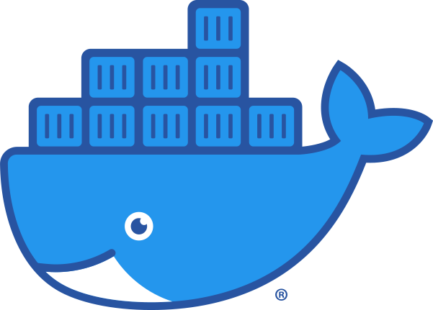
Development Environment
Portable
Minimum dependencies on the host
Same environment for DEV and TEST
Optimized for Dev (local mount, no NGINX)
Worker
Postgres
Netbox
Redis (Cache + Queue)
volume mount
Host

Slide 22
Dockerfile
ARG python_ver=3.7
FROM python:${python_ver}
ARG netbox_ver=master
ENV PYTHONUNBUFFERED 1
RUN mkdir -p /opt
RUN pip install --upgrade pip && pip install poetry
# Install NetBox
RUN git clone --single-branch --branch ${netbox_ver} https://github.com/netbox-community/netbox.git /opt/netbox/ && \
cd /opt/netbox/ && \
pip install -r /opt/netbox/requirements.txt
# Install Netbox Plugin
RUN mkdir -p /source
WORKDIR /source
COPY . /source
RUN poetry config virtualenvs.create false \
&& poetry install --no-interaction --no-ansi
WORKDIR /opt/netbox/netbox/

Slide 23
Dockerfile
ARG python_ver=3.7
FROM python:${python_ver}
ARG netbox_ver=master
ENV PYTHONUNBUFFERED 1
RUN mkdir -p /opt
RUN pip install --upgrade pip && pip install poetry
# Install NetBox
RUN git clone --single-branch --branch ${netbox_ver} https://github.com/netbox-community/netbox.git /opt/netbox/ && \
cd /opt/netbox/ && \
pip install -r /opt/netbox/requirements.txt
# Install Netbox Plugin
RUN mkdir -p /source
WORKDIR /source
COPY . /source
RUN poetry config virtualenvs.create false \
&& poetry install --no-interaction --no-ansi
WORKDIR /opt/netbox/netbox/

Slide 24
Dockerfile
ARG python_ver=3.7
FROM python:${python_ver}
ARG netbox_ver=master
ENV PYTHONUNBUFFERED 1
RUN mkdir -p /opt
RUN pip install --upgrade pip && pip install poetry
# Install NetBox
RUN git clone --single-branch --branch ${netbox_ver} https://github.com/netbox-community/netbox.git /opt/netbox/ && \
cd /opt/netbox/ && \
pip install -r /opt/netbox/requirements.txt
# Install Netbox Plugin
RUN mkdir -p /source
WORKDIR /source
COPY . /source
RUN poetry config virtualenvs.create false \
&& poetry install --no-interaction --no-ansi
WORKDIR /opt/netbox/netbox/

Slide 25
Docker Compose (partial)
services:
netbox:
build:
context: ../
dockerfile: development/Dockerfile
image: "ntc-netbox-plugin-onboarding/netbox:${NETBOX_VER}-py${PYTHON_VER}"
command: >
sh -c "python manage.py migrate && python manage.py runserver 0.0.0.0:8000"
env_file: ./dev.env
volumes:
- ./netbox_${NETBOX_VER}/configuration.py:/opt/netbox/netbox/netbox/configuration.py
- ../netbox_onboarding:/source/netbox_onboarding
worker:
build:
context: ../
dockerfile: development/Dockerfile
image: "ntc-netbox-plugin-onboarding/netbox:${NETBOX_VER}-py${PYTHON_VER}"
command: sh -c "python manage.py rqworker"
env_file: ./dev.env
volumes:
- ./netbox_${NETBOX_VER}/configuration.py:/opt/netbox/netbox/netbox/configuration.py
- ../netbox_onboarding:/source/netbox_onboarding
postgres:
image: postgres:10
env_file: dev.env
volumes:
- pgdata_netbox_onboarding:/var/lib/postgresql/data
redis:
image: redis:5-alpine
env_file: ./dev.env
volumes:
pgdata_netbox_onboarding:

Slide 26
Docker Compose (partial)
services:
netbox:
build:
context: ../
dockerfile: development/Dockerfile
image: "ntc-netbox-plugin-onboarding/netbox:${NETBOX_VER}-py${PYTHON_VER}"
command: >
sh -c "python manage.py migrate && python manage.py runserver 0.0.0.0:8000"
env_file: ./dev.env
volumes:
- ./netbox_${NETBOX_VER}/configuration.py:/opt/netbox/netbox/netbox/configuration.py
- ../netbox_onboarding:/source/netbox_onboarding
worker:
build:
context: ../
dockerfile: development/Dockerfile
image: "ntc-netbox-plugin-onboarding/netbox:${NETBOX_VER}-py${PYTHON_VER}"
command: sh -c "python manage.py rqworker"
env_file: ./dev.env
volumes:
- ./netbox_${NETBOX_VER}/configuration.py:/opt/netbox/netbox/netbox/configuration.py
- ../netbox_onboarding:/source/netbox_onboarding
postgres:
image: postgres:10
env_file: dev.env
volumes:
- pgdata_netbox_onboarding:/var/lib/postgresql/data
redis:
image: redis:5-alpine
env_file: ./dev.env
volumes:
pgdata_netbox_onboarding:

Slide 27
Docker Compose (partial)
services:
netbox:
build:
context: ../
dockerfile: development/Dockerfile
image: "ntc-netbox-plugin-onboarding/netbox:${NETBOX_VER}-py${PYTHON_VER}"
command: >
sh -c "python manage.py migrate && python manage.py runserver 0.0.0.0:8000"
env_file: ./dev.env
volumes:
- ./netbox_${NETBOX_VER}/configuration.py:/opt/netbox/netbox/netbox/configuration.py
- ../netbox_onboarding:/source/netbox_onboarding
worker:
build:
context: ../
dockerfile: development/Dockerfile
image: "ntc-netbox-plugin-onboarding/netbox:${NETBOX_VER}-py${PYTHON_VER}"
command: sh -c "python manage.py rqworker"
env_file: ./dev.env
volumes:
- ./netbox_${NETBOX_VER}/configuration.py:/opt/netbox/netbox/netbox/configuration.py
- ../netbox_onboarding:/source/netbox_onboarding
postgres:
image: postgres:10
env_file: dev.env
volumes:
- pgdata_netbox_onboarding:/var/lib/postgresql/data
redis:
image: redis:5-alpine
env_file: ./dev.env
volumes:
pgdata_netbox_onboarding:

Slide 28
Docker Compose (partial)
services:
netbox:
build:
context: ../
dockerfile: development/Dockerfile
image: "ntc-netbox-plugin-onboarding/netbox:${NETBOX_VER}-py${PYTHON_VER}"
command: >
sh -c "python manage.py migrate && python manage.py runserver 0.0.0.0:8000"
env_file: ./dev.env
volumes:
- ./netbox_${NETBOX_VER}/configuration.py:/opt/netbox/netbox/netbox/configuration.py
- ../netbox_onboarding:/source/netbox_onboarding
worker:
build:
context: ../
dockerfile: development/Dockerfile
image: "ntc-netbox-plugin-onboarding/netbox:${NETBOX_VER}-py${PYTHON_VER}"
command: sh -c "python manage.py rqworker"
env_file: ./dev.env
volumes:
- ./netbox_${NETBOX_VER}/configuration.py:/opt/netbox/netbox/netbox/configuration.py
- ../netbox_onboarding:/source/netbox_onboarding
postgres:
image: postgres:10
env_file: dev.env
volumes:
- pgdata_netbox_onboarding:/var/lib/postgresql/data
redis:
image: redis:5-alpine
env_file: ./dev.env
volumes:
pgdata_netbox_onboarding:

Slide 29
Invoke Simple CLI

Slide 30
Invoke
Easily create simple Alias to hide long & repetitive cli commands
Written Python > Portable
git:(master) invoke build --help
Usage: inv[oke] [--core-opts] build [--options] [other tasks here ...]
Docstring:
Build all docker images.
Args:
context (obj): Used to run specific commands
netbox_ver (str): NetBox version to use to build the container
python_ver (str): Will use the Python version docker image to build from
Options:
-n STRING, --netbox-ver=STRING
-p STRING, --python-ver=STRING
docker-compose -f {COMPOSE_FILE} -p {BUILD_NAME} build --build-arg netbox_ver={netbox_ver} --build-arg python_ver={python_ver}

Slide 31
Invoke / tasks.py
import os
from invoke import task
PYTHON_VER = os.getenv("PYTHON_VER", "3.7")
NETBOX_VER = os.getenv("NETBOX_VER", "master")
NAME = os.getenv("IMAGE_NAME", "ntc-netbox-plugin-onboarding")
PWD = os.getcwd()
COMPOSE_FILE = "development/docker-compose.yml"
BUILD_NAME = "netbox_onboarding"
@task
def build(context, netbox_ver=NETBOX_VER, python_ver=PYTHON_VER):
"""Build all docker images.
Args:
context (obj): Used to run specific commands
netbox_ver (str): NetBox version to use to build the container
python_ver (str): Will use the Python version docker image to build from
"""
context.run(
f"docker-compose -f {COMPOSE_FILE} -p {BUILD_NAME} build --build-arg netbox_ver={netbox_ver} --build-arg python_ver={python_ver}",
env={"NETBOX_VER": netbox_ver, "PYTHON_VER": python_ver},
)

Slide 32
Invoke / commands
Manage Dev Environment
build Build all docker images.
debug Start NetBox and its dependencies in debug mode.
destroy Destroy all containers and volumes.
start Start NetBox and its dependencies in detached mode.
stop Stop NetBox and its dependencies.
Utility
cli Launch a bash shell inside the running NetBox container.
create-user Create a new user in django (default: admin), will prompt for password.
makemigrations Run Make Migration in Django.
nbshell Launch a nbshell session.

Slide 33
Testing & Linting

Slide 34
Testing / Linting
Code Formatting Black
Code Analysis Pylint and Bandit
Doc Analysis Pydocstyle
Unit Tests Django-test

Slide 35
API Unit Tests
from django.contrib.auth.models import User
from django.test import TestCase
from django.urls import reverse
from rest_framework import status
from rest_framework.test import APIClient
from users.models import Token
from dcim.models import Site
from netbox_onboarding.models import OnboardingTask
class OnboardingTaskTestCase(TestCase):
"""Test the OnboardingTask API."""
def setUp(self):
"""Create a superuser and token for API calls."""
self.user = User.objects.create(username="testuser", is_superuser=True)
self.token = Token.objects.create(user=self.user)
self.client = APIClient()
self.client.credentials(HTTP_AUTHORIZATION=f"Token {self.token.key}")
self.base_url_lookup = "plugins-api:netbox_onboarding-api:onboardingtask"
self.site1 = Site.objects.create(name="USWEST", slug="uswest")
self.onboarding_task1 = OnboardingTask.objects.create(ip_address="10.10.10.10", site=self.site1)
self.onboarding_task2 = OnboardingTask.objects.create(ip_address="192.168.1.1", site=self.site1)
def test_list_onboarding_tasks(self):
"""Verify that OnboardingTasks can be listed."""
url = reverse(f"{self.base_url_lookup}-list")
response = self.client.get(url)
self.assertEqual(response.status_code, status.HTTP_200_OK)
self.assertEqual(response.data["count"], 2)

Slide 36
Run Unit Tests
invoke unittest --help
Usage: inv[oke] [--core-opts] unittest [--options] [other tasks here ...]
Docstring:
Run Django unit tests for the plugin.
Args:
context (obj): Used to run specific commands
netbox_ver (str): NetBox version to use to build the container
python_ver (str): Will use the Python version docker image to build from
Options:
-n STRING, --netbox-ver=STRING
-p STRING, --python-ver=STRING
docker-compose -f {COMPOSE_FILE} -p {BUILD_NAME} run netbox sh -c "python manage.py test netbox_onboarding”

Slide 37
Travis CI
Continuous Integration

Slide 38
Continuous Integration / Travis CI
---
language: python
python:
- "3.6"
- "3.7"
- "3.8"
# Each version of NetBox listed here must have a corresponding directory/configuration file
# under development/netbox_<NETBOX_VER>/configuration.py
env:
- NETBOX_VER=v2.8.3
- NETBOX_VER=master
services:
- docker
before_script:
- pip install invoke docker-compose poetry
script:
- invoke build --python-ver $TRAVIS_PYTHON_VERSION
- invoke tests --python-ver $TRAVIS_PYTHON_VERSION

Slide 39
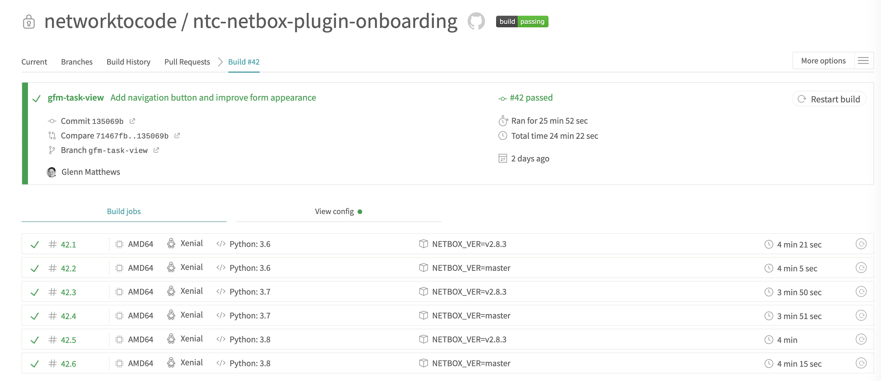
Continuous Integration / Travis CI

Slide 40
Tool Box Recap
Poetry
Manage your dependencies Manage your virtual environment Build and Publish to Pypi
Alternatives : setup.py | requirements.txt
Docker-Compose
Create a working NetBox environment (DB, Redis)
Easy to get started
Alternatives : VMs
Invoke
Create CLI commands for repetitive and long tasks
Alternatives : Makefile, Bash script
Pylint & Bandit Ensure code is clean and is following project guidelines
Alternatives : many
Django Unit Test
Ensure code is working as expected
Alternatives : pytest-django
Travis CI
Automatically run all linting and unit tests on every commit
Alternatives : GitHub Actions, Jenkins,

Slide 41
Get Started
Project is on GitHub
https://github.com/networktocode/ntc-netbox-plugin-onboarding
Install from Pypi
pip install ntc-netbox-plugin-onboarding

Slide 42
Thanks

Slide 43
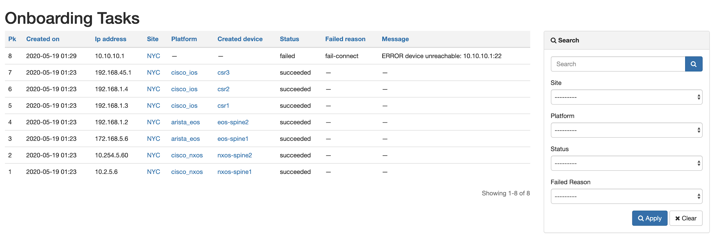
Onboarding Tasks View

Slide 44
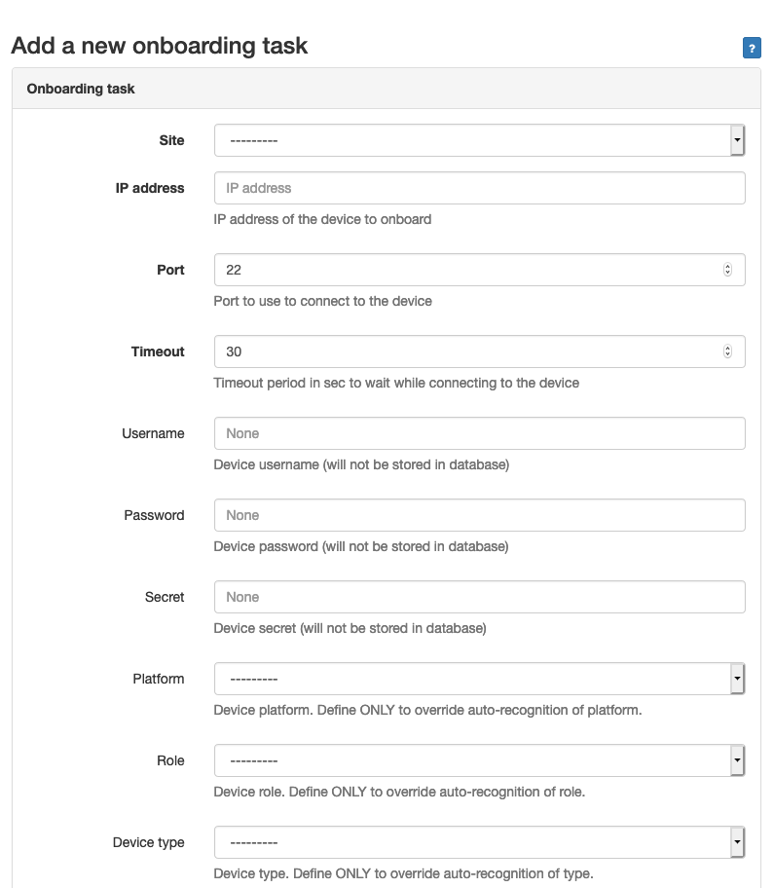
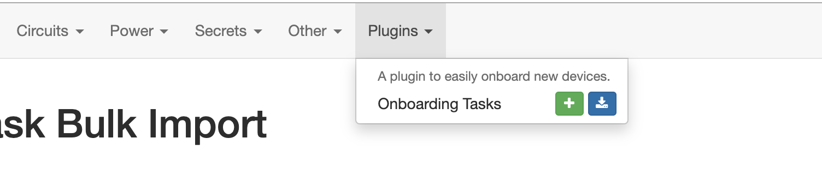
NetBox Onboarding Plugin Overview

Slide 45
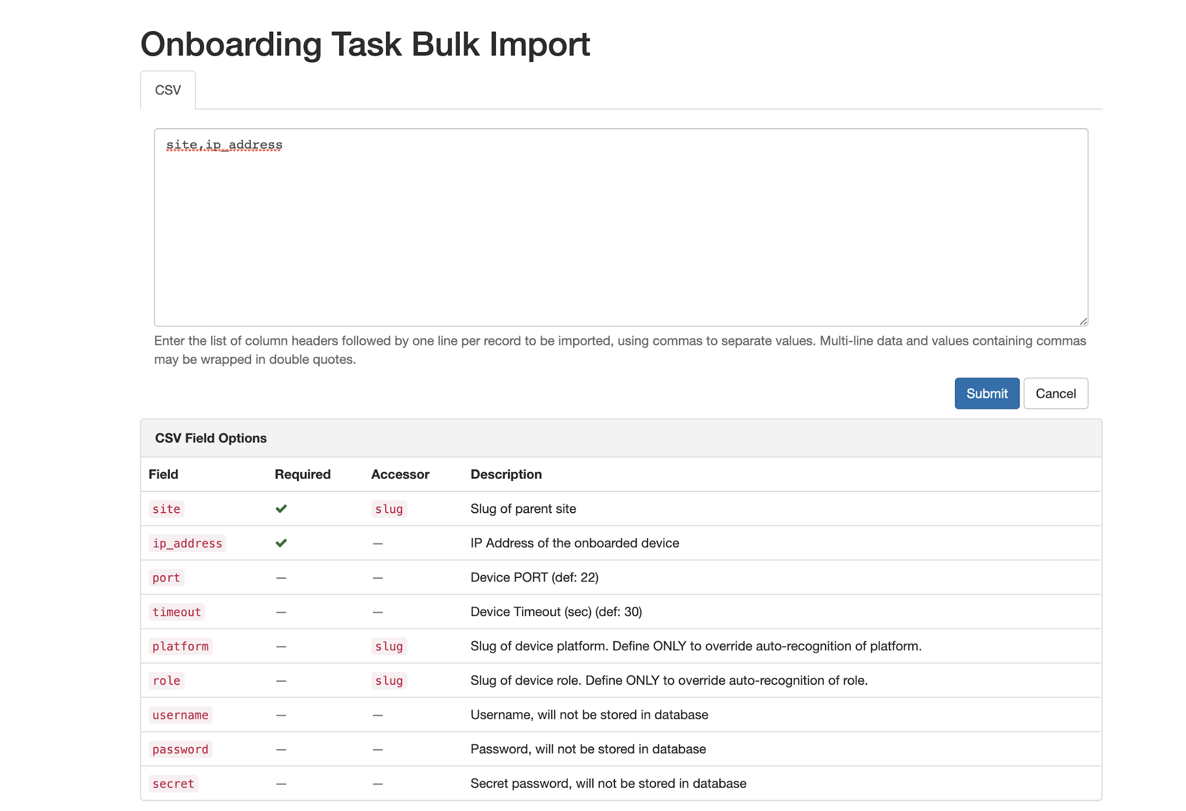
NetBox Onboarding Plugin Overview

